Slide 1

Document heading in Calibri Light green
Image for illustrative purposes only!
Replacing cover image
Replace the image in one of two ways.
Delete existing image, click the picture icon to navigate to a new image and ‘click’ insert.
Select the image, ‘right click’, and select Change Picture. Browse to a new image and ‘click’ Insert.
Once the image has been inserted on this slide, make sure to right-click and choose “send to back”.
Image library is available here.
Subtitle, date or author second line

Slide 2
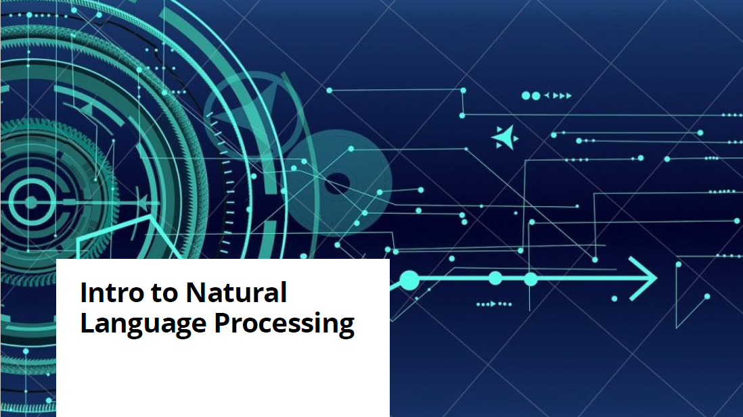

Slide 3

Natural Language processing
Natural language processing (NLP) refers to the branch of computer science, and more specifically, the branch of artificial intelligence concerned with enabling computers to understand human languages.
The terms text analytics or text mining are also commonly used.

Slide 4
Natural Language processing
Understanding humans… for what purpose?
“A computer could be considered intelligent if it could carry out a conversation with a human being without the human realizing they were talking to a machine.”
– Alan Turing

Slide 5










Natural Language processing
NLP common applications
Text classification ( ex: emails filtering)
NER: Named Entity Recognition
spam
Text summarization
Sentiment Analysis
Question-Answering
(Chatbots: Siri, Alexa, Google ….)
Translation
Speech recognition
I have forwarded
my resume
Text prediction/ correction/ text generation

Slide 6

Natural Language processing
Data types

Slide 7
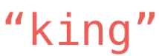
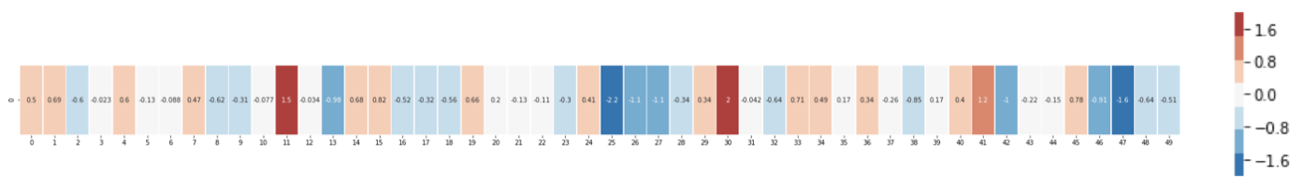
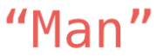

Natural Language processing
How to represent words?
1. Most intuitive way to create embeddings
2. Word2Vec: generating embeddings to group words by semantic similarity
feature 1
feature 50
feature 2

Slide 8
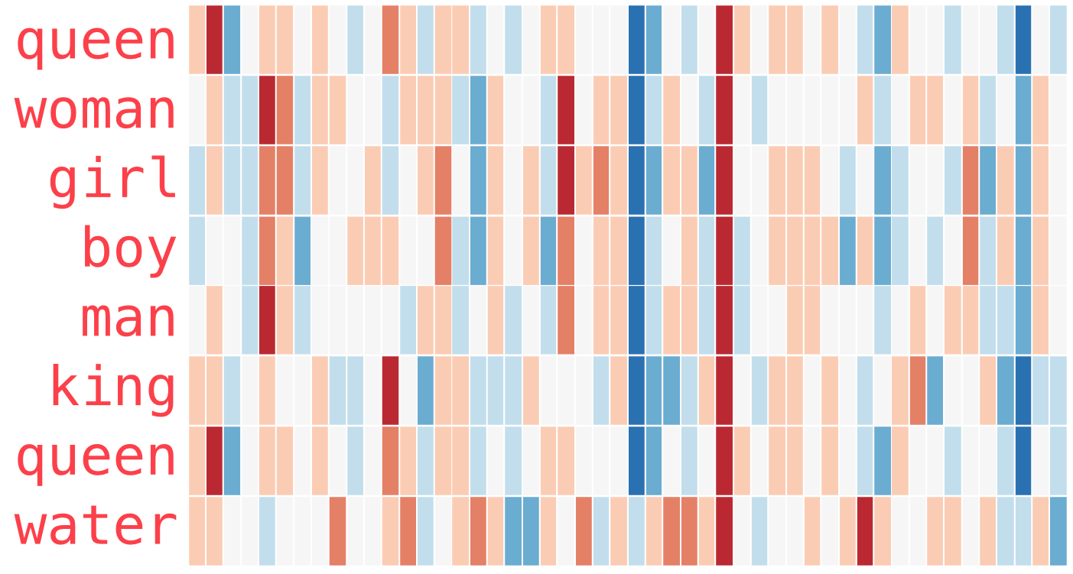
Natural Language processing
How to represent words?
2. Word2Vec: generating embeddings to group words by semantic similarity

Slide 9
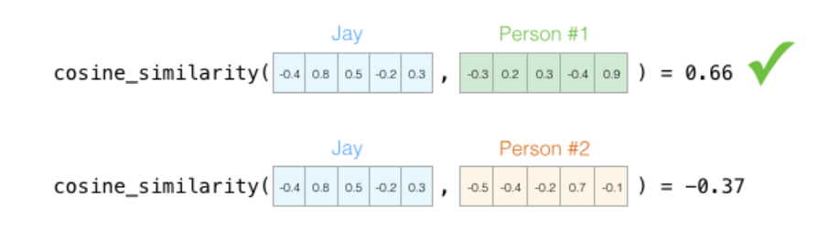
Natural Language processing
How to represent words?
Word2Vec enables operations
Word #1
Word #2
Word #1
Word #3

Slide 10
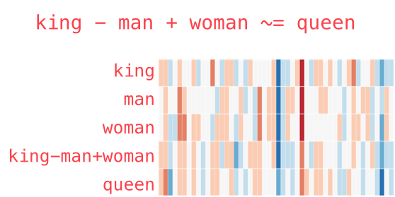
Natural Language processing
How to represent words?
Word2Vec enables operations
The Illustrated Word2vec – Jay Alammar – Visualizing machine learning one concept at a time. (jalammar.github.io)
The resulting vector from "king-man+woman" doesn't exactly equal "queen", but "queen" is the closest word to it from the 400,000 word embeddings we have in this collection.

Slide 11
Natural Language processing
How to represent a whole text?
Machine learning techniques can be applicable only on structured data or structured representation of unstructured data.
Vectorization of documents
represent each text document with a structured numeric vector (e.g binary vectorization)
vectorization of entire text documents brings the problem of excessive dimensionality
each form of a word or phrase represents a dimension
problem eliminated by using NLP techniques for text preprocessing

Slide 12
Natural Language processing
How to represent a whole text?
A bag of words BoW is a representation of text that describes the occurrence of words within a document.
Sentence 1: ”Welcome to Deloitte Academy, Now start learning”
Sentence 2: “Learning is a good practice”
[“Welcome”, “to”, “Deloitte”, “Academy”, “,”, ”Now”, “start”, “learning” ,“is”, “a”, “good”, “Practice”]
Sentence | Welcome | to | Deloitte | Academy | , | Now | start | learning | is | a | good | practice
Sentence1 | 1 | 1 | 1 | 1 | 1 | 1 | 1 | 1 | 0 | 0 | 0 | 0
Sentence2 | 0 | 0 | 0 | 0 | 0 | 0 | 0 | 1 | 1 | 1 | 1 | 1

Slide 13
Natural Language processing
How to represent a whole text?
Sentence 1: ”Welcome to Deloitte Academy, Now start learning”
Sentence 2: “Learning is a good practice”
Query: “Deloitte Academy is good to learn”
Sentence 1: [0, 1, 1, 0, 1, 0, 0, 1, 0, 1, 1, 1]
Sentence 2: [0, 0, 0, 1, 1, 1, 1, 0, 1, 0, 0, 0]
Query: [1, 1, 1, 0, 0, 0, 1, 0, 1, 0, 0, 1]
Cosinus_similarity(Sentence1, Query)= 0.46
Cosinus_similarity(Sentence2, Query)= 0.37
What if the query is “Deloitte Academy is good for learning”?
Cosinus_similarity(Sentence1, new_Query)= 0.62
Cosinus_similarity(Sentence2, new_Query)= 0.55

Slide 14
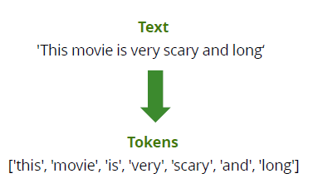
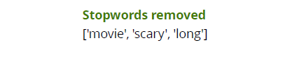
Natural Language processing
How to pre-process text data?
Tokenization
Split your text files into words
Stop words
List of words that hold no additional information and can be removed from the list of words such as ‘The’, ’about’, ‘this’, ‘which’ ….

Slide 15
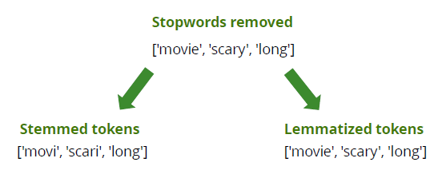
Natural Language processing
How to pre-process text data?
Lemmatization
lemma of a word is its dictionary or canonical form. The Lemma of ‘is’, ’are’ and ’were’ is the verb ‘be’
Stemming
With stemming, words are reduced to their word stems. A word stem need not be the same root as a dictionary-based morphological root, it just is an equal to or smaller form of the word. The stem of ‘bodies’ and ‘body’ is ‘bodi’

Slide 16
Natural Language processing
How to pre-process text data?
Be careful when cleaning your data: don’t forget to lower all the cases !!
Language detection
Make sure you know what language you are working with to use the most adequate dictionary; you can also automatically translate your data for homogenization. Librairies such as NLTK, langdetect can be used for this purpose.
Spelling correction
Can be performed using NLTK
Emojis handling
you can use librairies such as emoji_translate to replace emojis with their signification

Slide 17
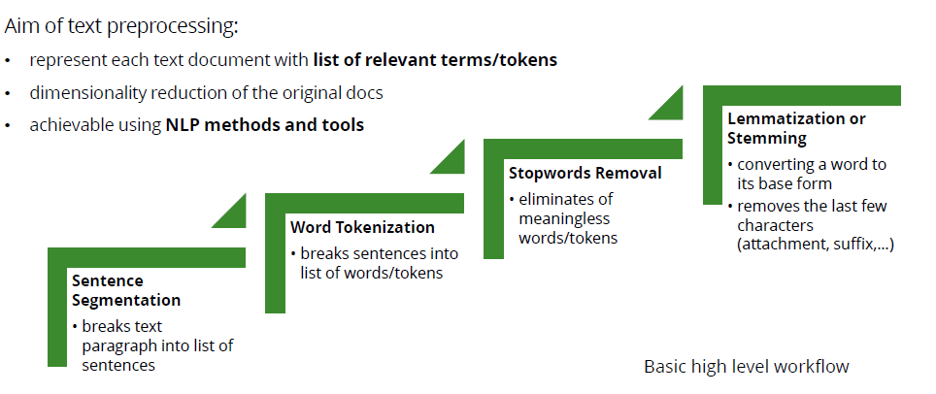
Natural Language processing
How to pre-process text data?

Slide 18
Natural Language processing
How to represent a whole text?
Sentence 1: ”drinking water is really good for your health”
Sentence 2: “smoking is not good for your health”
[‘drink’,’water’,’really’,’good’,’health’, ’smok’, ’not’]
Sentence | Drink | Water | Really | Good | Health | Smok | Not
Sentence1 | 1 | 1 | 1 | 1 | 1 | 0 | 0
Sentence2 | 0 | 0 | 0 | 1 | 1 | 1 | 1
positive
negative
N-Grams is an N-token sequence of words: a 2-gram (more commonly called a bigram) is a two-word sequence of words like “really good”, “not good”, or “your homework”, and a 3-gram (more commonly called a trigram) is a three-word sequence of words like “not at all”, or “turn off light”.

Slide 19
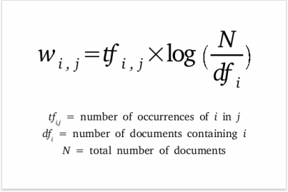
Natural Language processing
How to represent a whole text?
Bag-Of-Words: occurrence of words
Tf-Idf is intended to reflect how relevant a term is in a given document. The word ‘client’ might appear multiple times in a contract, but it wouldn’t give us any relevant information about the contract itself.
The term frequency (TF) of a word in a document.
The inverse document frequency(IDF) of the word across a set of documents. This suggests how common or rare a word is in the entire document set. The closer it is to 0, the more common is the word.

Slide 20
Natural Language processing
POS: Part-of-speech tagging and NER
POS tagging is the process of categorizing words in a corpus in correspondence with a particular part of speech depending on the definition of the word and the context.
Deloitte Academy offers a data - science course in Prague
[Noun] [Noun] [Verb] [Determiner] [Noun]-[Noun] [Noun] [Prep] [Noun]
Deloitte Academy offers a data - science course in Prague
[ ORG ] [Verb] [Determiner] [Noun]-[Noun] [Noun] [Prep] [GPE]
Named Entity Recognition (NER) identifies entities (country, people names, locations, organisations…) and type of information such as money, date, …

Slide 21



Natural Language processing
POS: Part-of-speech tagging and NER
Three basic methods:
Gazetteer methods (list of NEs)
search all occurrences of NEs from lists in a target strings
Rule–based extraction
linguistic grammar-based techniques
Semi-supervised/supervised machine learning
ER is solved as classification task for each token in a sequence

Slide 22

Natural Language processing
Classification
Grouping texts into predefined categories based on their content
Applications:
Intent detection / Binary classification
categories: Interested / Not Interested or spam/ not spam
Topic modelling
categories: politics / sport / …
Sentiment analysis
categories: negative / neutral / positive sentiment
Language detection
categories: English / Czech / …

Slide 23
Natural Language processing
Topic modelling
Topic modeling is a statistical modeling for discovering the abstract “topics” that occur in a collection of documents.
FDA Approves Pfizer's COVID-19 Vaccine…
Health
U.S. President Barack Obama makes remarks to a Democratic National Committee fundraiser at the historic Warner Theatre, in Washington
Politics
France vs. Croatia odds, picks, prediction: Soccer expert reveals UEFA Nations League bets for Monday, June 13
Sport
Barack Obama Attends Bulls-Celtics Game During Visit to ...
Politics or Sports?

Slide 24
Natural Language processing
Topic modelling
Two basic methods:
Rule based/ keywords- based approach
Suppose we have lis of keywords related to sports and politics:
Sports= [football, basketball, LeBron James]
Politics = [Barack Obama, Donald Trump, Hillary Clinton, Putin]
Keywords are now used for text classification:
Text = “When is LeBron James' first game with the Lakers? “
Count the number of words in the text related to:
Sports→ 1
Politics→ 0
text is classified as sports

Slide 25
Natural Language processing
Topic modelling
Machine learning model (surpervised or unsupervised)
Allow grouping of texts into groups based on their similarity
without training data (clusters are recognized automatically)
used for Content analysis, clustering
Calculation of similarity
based on comparing vector representations of texts
Similarity of texts == similarity of numeric vectors of texts
metrics: Cosine similarity, Euclidean distance,…
Methods
unsupervised ML methods for clustering (k-means,…)

Slide 26
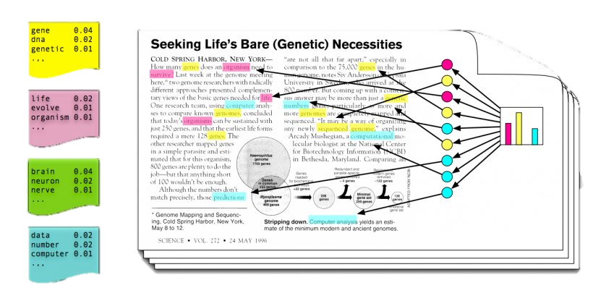
Natural Language processing
Topic modelling
Machine learning model: LDA
In LDA, documents are represented as a mixture of topics and a topic is a bunch of words

Slide 27
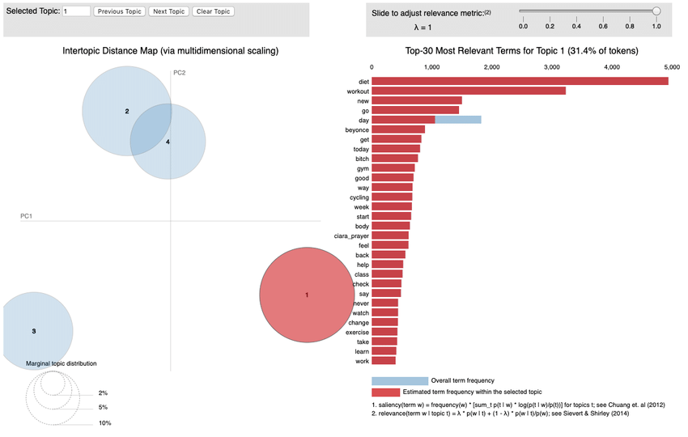
Natural Language processing
Topic modelling
Machine learning model: LDA
With LDA you obtain the most common keywords of each topic and the size of the cluster. Overlapping topics can also be visualized.

Slide 28

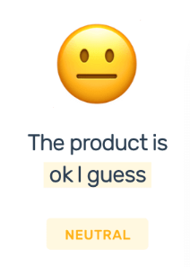


Natural Language processing
Sentiment analysis
Sentiment analysis is key to monitor brand and products sentiment in customer feedbacks and understand customer needs. It can also be used to assess more critical risks such as reputation risks when collaborating with a new outsourcer or detect insider’s trading by analyzing tweets.

Slide 29

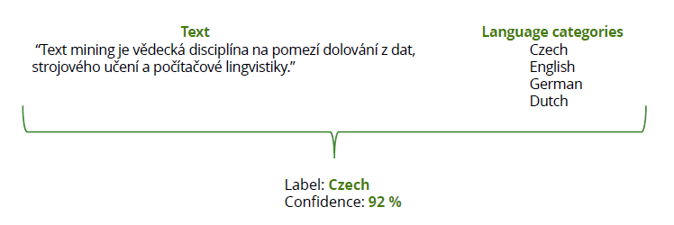
Natural Language processing
Language detection
Process of classifying incoming text according to its language: used to homogenize a large dataset (e.g google play app reviews) or routing purposes (e.g route support tickets to the appropriate team)

Slide 30

Natural Language processing
Next-word prediction
This is called a Continuous Bag of Words. Instead of guessing a word based on its context (the words before and after it), this other architecture tries to guess neighboring words using the current word.

Slide 31

Natural Language processing: Transformers
Attention is all you need
I left my passport on the left side of the table in Prague.
Could you find it?

Slide 32
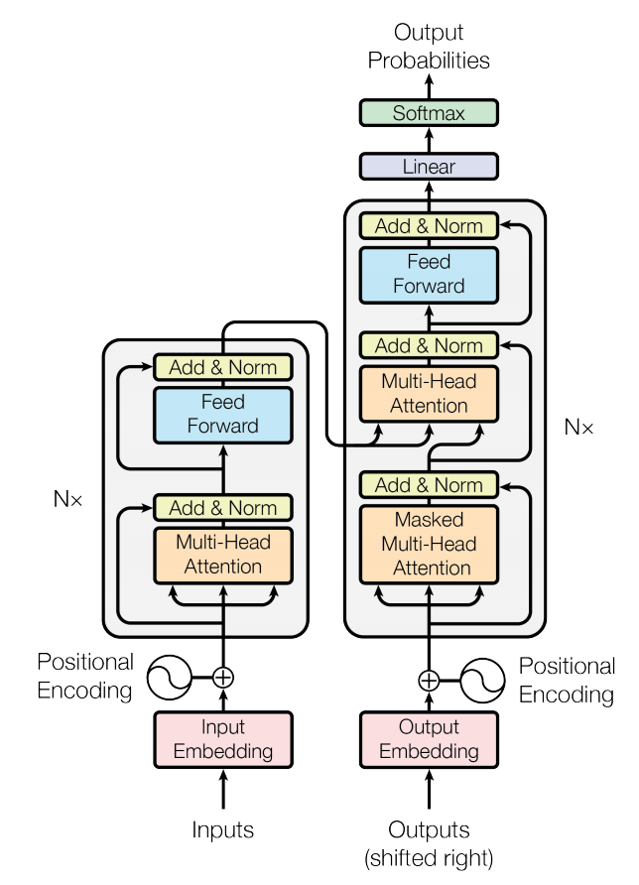


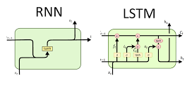
Natural Language processing: Transformers
Attention is all you need
VS

Slide 33
Natural Language processing: Transformers
Attention is all you need
Bidirectional Encoder Representations from Transformers(BERT)
a pre-trained NLP model developed by Google in 2018
the model has a wide application across NLP tasks
works as Transformer Encoder:
Word embedding
transforms tokens into its vector representation
each token == vector of 768 weight
Sentence/document embedding
transforms sentence/document into its vector representation
each doc== vector of 768 weight
[CLS] vector
represents a vector representation of the original documents
http://jalammar.github.io/illustrated

Slide 34
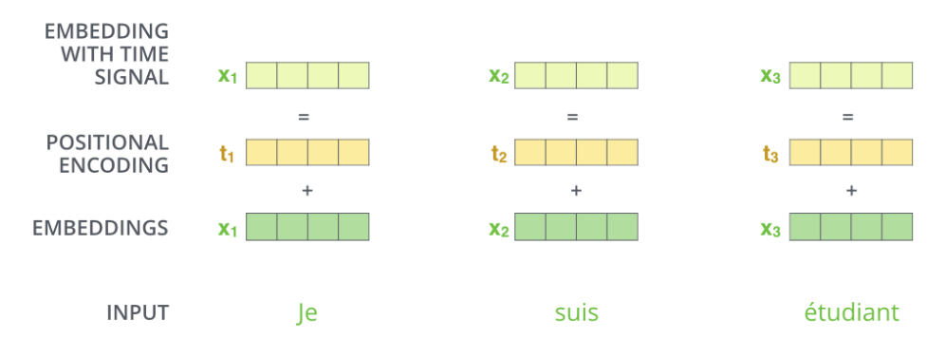
Natural Language processing: Transformers
Attention is all you need
The transformer adds a vector to each input embedding. These vectors follow a specific pattern that the model learns, which helps it determine the position of each word, or the distance between different words in the sequence.

Slide 35
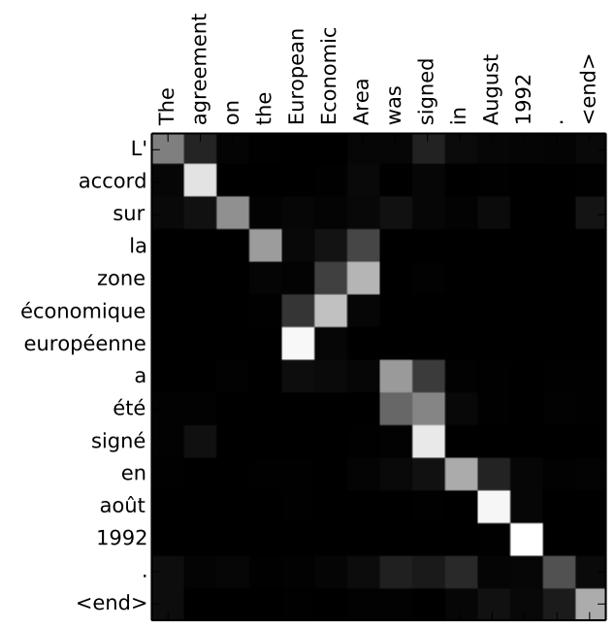
Natural Language processing: Transformers
Attention is all you need

Slide 36
Natural Language processing: Transformers
Text classification with transformers

Slide 37
Natural Language processing: Transformers
Sentiment analysis with transformers

Slide 38
Natural Language processing: Transformers
Sentiment analysis with transformers
1. Use DistilBERT for feature extraction

Slide 39
Natural Language processing: Transformers
Sentiment analysis with transformers
1. Use DistilBERT for feature extraction

Slide 40
Natural Language processing: Transformers
Sentiment analysis with transformers
1. Use DistilBERT for feature extraction

Slide 41
Natural Language processing: Transformers
Sentiment analysis with transformers
1. Use DistilBERT for feature extraction

Slide 42
Natural Language processing: Transformers
Sentiment analysis with transformers
2. Splitting of the dataset into training and testing part

Slide 43
Natural Language processing: Transformers
Sentiment analysis with transformers
3. Logistic regression model training

Slide 44
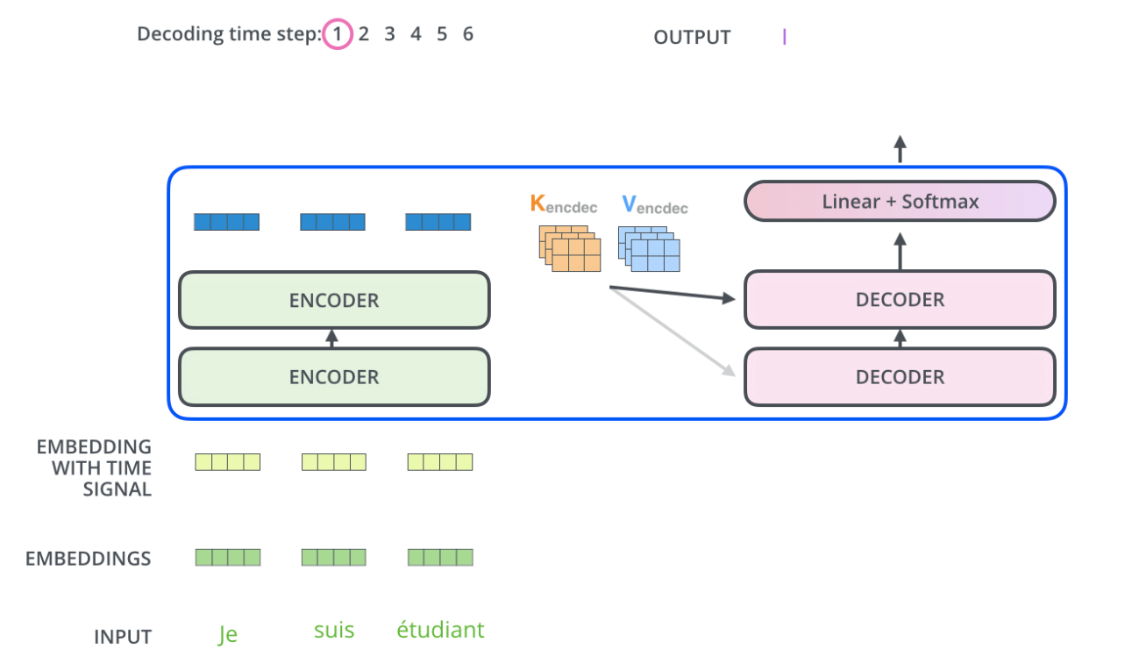
Natural Language processing
Translation
am a student

Slide 45
Natural Language processing
Summarization
Text summarization is the technique for generating a concise and precise summary of voluminous texts while focusing on the sections that convey useful information, and without losing the overall meaning.
https://medium.com/@ondenyi.eric/extractive-text-summarization-techniques-with-sumy-3d3b127a0a32

Slide 46
Natural Language processing
Summarization
Two basic approaches to text summarization:
Extractive Summarization
extracts several parts, such as phrases and sentences, from a piece of text and stack them together to
create a summary.
the summary obtained contains exact sentences from the original text
Abstractive Summarization
Use advanced NLP techniques to generate an entirely new summary.
the summary obtained does not contain exact sentences from the original text

Slide 47
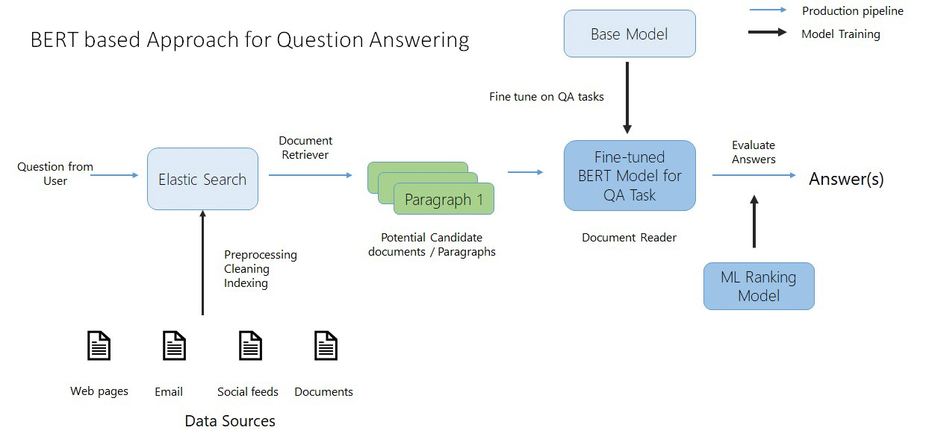
Natural Language processing
Question-answering

Slide 48
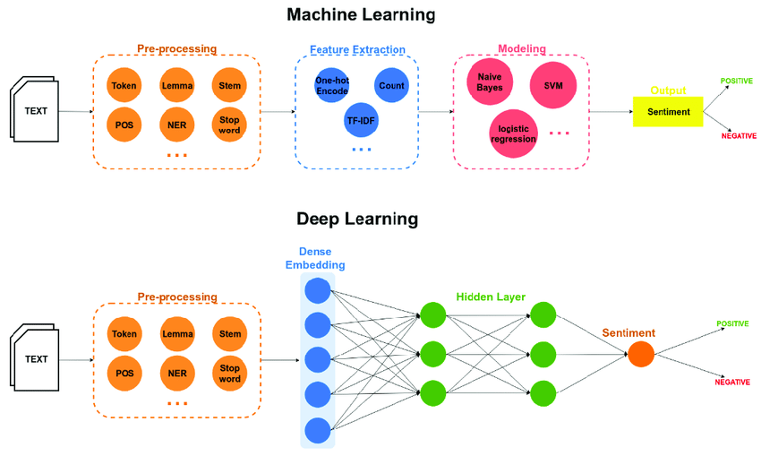
Natural Language processing
Feature extraction
pre-trained layers (BERT,…)
Classification
Trained for a specific purpose

